Slide 1
Machine learning
Supervised Learning : Classification

Slide 2
Content
k-Nearest Neighbors (kNN)
Naive Bayes
Logistic Regression
Classification Trees

Slide 3
k-Nearest Neighbors (kNN)

Slide 4
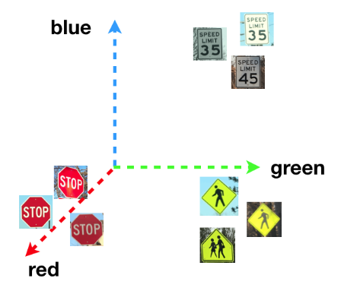
Feature Space

